Slide 1
Unstuck and Unstoppable!
Your Writing Goals for 2026
Sweet Romance Author, Becke Turner
2025 Moonlight & Magnolia

Slide 2
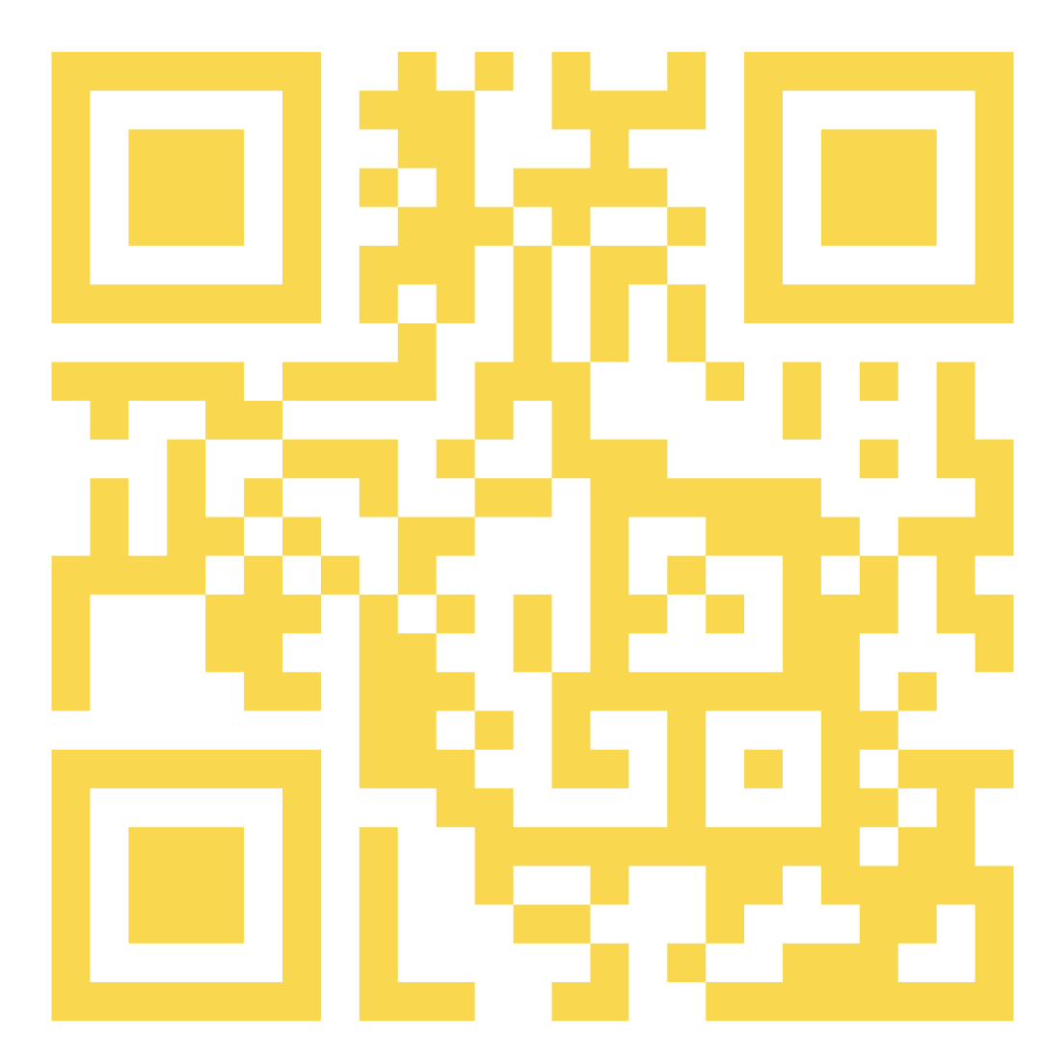
Handout Link https://tinyurl.com/UnstopSheet

Slide 3
WELCOME & PURPOSE
You came here with a purpose
  Improve your writing craft
  Expand your publishing, business knowledge
  Connect with influencers and fellow writers
Not let’s turn that energy into action—
  Start building your 2026 writing game plan today
"Success is not for the chosen few, it’s for the few who choose it." — Unknown
Notes:
0:00 – 0:03 | Welcome & Purpose
Thank you so much for choosing to spend this hour with me. But I’m merely your guide because this workshop is for you.
I went to my first RWA conference in 1997, in Orlando, Florida. I was starstruck—authors I’d admired for years were suddenly right there in front of me. I came home buzzing with ideas. At that point, I’d already written ten romance novels, but I still felt like a sponge, soaking up everything. Some ideas I used right away, but a lot slipped through the cracks once life took over.
I kept going back, year after year, until I finaled in the Golden Heart in 2019. Every time I came home with at least one nugget that made a difference in my writing.
But I had friends who weren’t as lucky. They’d say, “I meant to… but I never got around to it.” They left conferences just as excited, but without a plan, they stalled out. And that’s why I created this workshop—so this year you don’t just leave here with inspiration, you leave with a 90-day plan you can actually put into action.
Success is not for the chosen few, it’s for the few who choose it."
Today is about moving from inspiration to action.”

Slide 4
WHAT YOU’LL WALK AWAY WITH
By this session’s end, you’ll have:
  A clear writing vision for 2026
  A jumpstart 90-day action plan
  Tools to stay focused and motivated
  A strategy to turn conference inspiration into lasting momentum
"The key is not to prioritize what's on your schedule, but to schedule your priorities." — Stephen Covey
Notes:
0:03 – 0:05 | WHAT YOU’LL WALK AWAY WITH (Slide 3)
The key is not to prioritize what's on your schedule, but to schedule your priorities." — Stephen Covey
WRITING IS A CHOICE!
You’ll walk away with the effort you put into that piece of paper I gave you!
No matter what your targeted goals are, you’re excited about what you just learned.
Let’s put it into action so at the end of 2026 and next conference you have something in your achievement purse and not I fizzled, farted, and failed!
Because once we go home, real life hits.
I have print copies for you or download them
But let’s make this focus—this idea a success
While we’re focusing on the big picture, you focus on you and your idea.
But don’t be stingy. Share. Energy is contagious!

Slide 5
Why did you attend the conference?
"Energy is contagious: either you affect people or you infect people.“— T. Harv Eker
Notes:
0:05 – 0:08| Why Are You Here?
My why is to pay it forward to all the authors who have helped me along my journey
Pick 2-3 volunteers
Write your WHY on the worksheet!
WHY fuels the action plan
Energy is contagious: either you affect people or you infect people

Slide 6

Your Voice Matters
There are no wrong answers.
There is no dumb question.
“When you share your story, you create space for others to share theirs.”
— Brené Brown
Notes:
0:08 – 0:10 | YOUR VOICE MATTERS
Before we dive into sharing, I want to remind you—this is a safe space. There are no wrong answers, and there is no dumb question. Every writer in this room has unique experiences, and your perspective might be the very thing that helps someone else. I love this Brené Brown quote because it captures that idea perfectly: when you share your story, you create space for others to share theirs. So speak up, ask questions, and know that your voice matters here.
EVERYTHING COUNTS!!!
If I say something or someone in this room says something that resonates with you WRITE IT ON YOUR WORKSHEET.

Slide 7

WHAT’S LIGHTING YOU UP?
What’s one idea or insight you want to carry home?
  A craft technique
  A business or publishing tip
  A novel way to connect with your writing community
  🎤Let’s hear it!!!
"You don’t find the time to write. You make the time. It’s not always easy. But it is always a choice."
Jami Attenberg
Notes:
0:10 – 0:15 | What’s Lighting You Up?
Take a minute to jot down one key idea or insight from the conference so far.
2-3 Volunteers
Transition: “Now let’s take those sparks and turn them into action.”
Naming an idea helps cements it in memory and sets the stage for turning it into action.

Slide 8
Choose your focus!
Choose Your Spark
Now choose your next move:
  Craft Ideas Table 1
  Writing Business Ideas Table 2
  Community/Connection Table 3
  Other Ideas (Wildcard) Table 4
"If it’s important to you, you’ll find a way. If not, you’ll find an excuse." — Ryan Blair
Notes:
0:15 – 0:19 | Choose Your Focus
✍️ Write down: *One idea that lit up your brain
Just one.
IF EVERYTHING IS A PRIORITY—NOTHING IS A PRIORITY
Yep, you’re going to work!
We’re going to take that spark and turn it into motion. Now let’s get moving! Go to the table that aligns with your spark. If you shared a business insight, join the business table. If your idea was craft-related, head to that one. These small groups are where you’ll start shaping your vision.
Depending on the type of idea you wrote down, go to the matching table.
We’re going to work with others who chose a similar focus.
Craft? Business? Community? Not sure? That’s what the Wildcard Table is for.
This gives you a chance to connect and brainstorm around something you care about."

Slide 9

VISION INTO MOTION
Table Discussions
  How will this idea show up in your writing life?
  What’s one first step?
  What are your obstacles?
"Discipline is choosing between what you want now and what you want most." — Attributed to Abraham Lincoln
Notes:
0:19 – 0:24| Vision Into Motion – Table Discussions
What’s the first step I can take in the next 7 days?”
Obstacles are normal—naming them is the first step to overcoming them.
Work, teenagers, life!
I got up at 4:30 before my crew for a few minutes of writing time.
This is the heart of your momentum. Take five minutes to discuss this with your table members. Talk with your group about how to put your spark into action. What could it look like in real life? What’s one doable step? What might hold you back—and how will you plan around it?

Slide 10
Don’t Get Stuck Before You Start
✍️ A New Writing Habit
💡 A Shift in Craft
💼 A Business Move
🤝 A Connection Commitment
🧭 A Career Strategy
"Start before you’re ready. Don’t prepare, begin.“— Mel Robbins
Notes:
0:24 – 0:27| Don’t Get Stuck Before You Start
Pick one—even if small—that they can start this week.
Stress the Mel Robbins quote: “Start before you’re ready”—taking action builds confidence faster than over-preparing.
”Writing habit: Time-blocking, daily word count, or morning sprints
Use this time to brainstorm an idea, create a synopsis, write a blurb
Don’t get stuck with RULES- sitting at your desk ‘thinking’ about your story counts.
Craft Shift: Deep POV, stronger hooks, or experimenting with a new trope
Business Move: Update your website, create a lead magnet, or start your email list
Connection: Join a mastermind, network online, or find a critique partner
Career Strategy: Outline your next book, pitch a series, or apply for a mentorship
Before hesitation kicks in, remind yourself—you don’t need to have it all figured out. Choose one way this idea could show up in your writing life. Start small and make it real.
That’s how we get unstuck.
Now let’s turn your idea into something specific and doable.”

Slide 11
SMART goals are REQUIRED!!!
S – Specific - What you want to accomplish?
M – Measurable - How will you track progress?
A – Achievable - Can you succeed?
R – Relevant - Does it align with your purpose?
T – Time-bound - What’s your deadline?
If you stumble on a step, don’t throw yourself down the stairs!! –Me!
Notes:
0:27 – 0:30| SMART Goals
Pick one action and rewrite it as a SMART goal
Remind them: vague goals = vague results.
Walk through the SMART acronym with an example:
Specific: “Write 3 chapters” vs. “Work on my novel.”
Measurable: “Track word count in a spreadsheet.”
Achievable: “Finish one chapter per week,” not “Write a book in a week.”
Relevant: It moves you closer to your publishing goals.
Time-bound: Set a deadline.

Slide 12

What Might Stop You?
⏰ Time Scarcity – “I don’t have time to write.”
💭 Self-Doubt – “Who am I to do this?”
🔍 Lack of Clarity – “I don’t know what to focus on.”
🎯 Perfectionism – “It has to be perfect before I start.”
❌ Fear of Failure or Rejection – “What if I try and it doesn’t work?”
"You don’t have to see the whole staircase, just take the first step.“— Martin Luther King Jr.
Notes:
0:30 – 0:33 | What Might Stop You?
Let’s be honest—goals are great, but roadblocks are real. These five are some of the most common that stop authors in their tracks.
You don’t need to solve them all today, but naming your biggest obstacle gives you power over it.
I wrote my first romance back in 1980 on a borrowed manual typewriter. Every page was a battle with mistakes, and when it came time to submit, my husband two-finger typed the manuscript so we could have a clean copy. We mailed it off to an agent, full of hope—and of course it came back with a rejection. But this one had a handwritten note: suggestions on what I could improve. I didn’t know then what I know now—that a handwritten note was actually a good rejection. To me, it just felt like failure.
At the time, I was a new mom in a new town, and my husband traveled four days a week. It would have been easy to quit right there. But what else was I going to do? I kept reading trade magazines, kept learning, and most importantly—I kept writing. That rejection didn’t end my story. It became the first step in a much longer one.
That rejection felt like failure. But looking back, it was progress. The only thing that would have stopped me was quitting—and that’s the one choice you can control.”
✨ “That rejection could have stopped me—but the only true failure would have been quitting. Every writer faces obstacles. What matters is choosing to keep moving forward, one step at a time.”

Slide 13
90-DAY SMART ACTION PLAN
Discuss
  What will you do this week?
  In 30 days?
  In 90 days?
Add to your plan.
"You will never ‘find’ time for anything. If you want time, you must make it." — Charles Buxton
Notes:
0:33 – 0:38 | 90-Day SMART Action Plan
Notes:
Guide them in filling out their worksheets.
Prompt: “What will you do this week, in 30 days, and in 90 days?”
Stress the importance of writing it down—goals on paper become commitments.
Circulate or check in while they’re working (if interactive format).
Time to turn intention into motion. Write down one thing you’ll do this week. Then a SMART goal to complete in 30 days. Finally, name a milestone to reach in 90 days that will make you feel proud. Keep it specific and achievable.
Take five minutes to discuss this with your table members. Talk with your group about how to put your spark into action. What could it look like in real life? What’s one doable step? What might hold you back—and how will you plan around it?
Then we’ll share in 5 minutes.

Slide 14
90-DAY SMART ACTION PLAN Review
5 Action Ideas to implement this week.
5 Action Ideas to implement by October 27th.
5 Action Ideas to implement by January 1
Pick one you can complete and add it to your worksheet
"We are kept from our goal not by obstacles but by a clear path to a lesser goal." — Robert Brault
Notes:
0:38 – 0:53 | REVIEW & DISCUSSION
Let’s hear one action you’ve written down for this week. Just one sentence—what will you do?”
1- Go around the room quickly so everyone can share. Keep it brisk.
OR
2- 1 person from each table.
Notice how specific and doable these are—this is how you build momentum.”
Notes:
Invite volunteers to share one action item they’re committing to.
Encourage peer applause/support—it reinforces accountability.
Remind them: don’t try to do everything—choose one small win for this week to build momentum.
Share time!!
Now you should have at least one action item you can commit to and complete by the first week, the first month, and the end of the quarter. This is where SMART comes in. Pick an action you, not your neighbor, can accomplish. Now please share. You may have the perfect idea for your neighbor or stimulate an even better idea.
Time to turn intention into motion. Write down one thing you’ll do this week. Then a SMART goal to complete in 30 days. Finally, name a milestone to reach in 90 days that will make you feel proud. Keep it specific and achievable.
Take five minutes to discuss this with your table members. Talk with your group about how to put your spark into action. What could it look like in real life? What’s one doable step? What might hold you back—and how will you plan around it?
Then we’ll share in 5 minutes.

Slide 15

This Week –Quick Wins…
Write or revise 1 scene or chapter
Create or update author bio
Contact a critique partner
Schedule 3 writing sessions in your calendar
Make a list of agents, contests, or comps to research
"You don’t have to be great to start, but you have to start to be great."— Zig Ziglar
Notes:
Which of these quick wins resonates with you most right now? Circle it or star it on your page.”
Then ask: “Who would like to share their chosen quick win?”
Time to turn intention into motion. Write down one thing you’ll do this week. Then a SMART goal to complete in 30 days. Finally, name a milestone to reach in 90 days that will make you feel proud. Keep it specific and achievable.

Slide 16
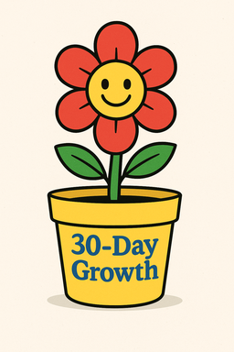
By Next Month – 30-Day Goals
Finish a short story or first 3 chapters of a novel.
Build a basic author website or landing page.
Read a craft book and apply one technique to your WIP.
Join a writing group or accountability pod.
Create a content calendar for your newsletter or social medial
"A goal without a plan is just a wish."— Antoine de Saint-Exupéry
Notes:
“Look at these 30-day ideas, which one would move you forward the most?”
Got a Better idea-Anyone?
Link it back to your spark!

Slide 17
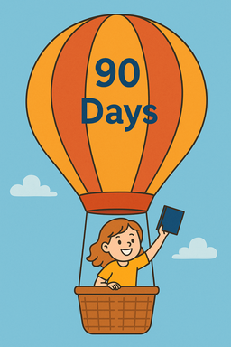
Within 90 Days
Complete a full draft or novella
Launch a reader magnet or prequel for list-building
Submit your work to a contest, agent, or editor.
Outline your next book or series arc
Plan a promo strategy or branding refresh for your next release.
"Success usually comes to those who are too busy to be looking for it."— Henry David Thoreau
Notes:
Time to turn intention into motion. Write down one thing you’ll do this week. Then a SMART goal to complete in 30 days. Finally, name a milestone to reach in 90 days that will make you feel proud. Keep it specific and achievable.
Take five minutes to discuss this with your table members. Talk with your group about how to put your spark into action. What could it look like in real life? What’s one doable step? What might hold you back—and how will you plan around it?
Then we’ll share in 5 minutes.

Slide 18
ACCOUNTABILITY MATTERS!!
  Select your support system
  Writing partner
  Online group
  Planner or ap
  Calendar reminders
"Decide what you want. Write it down. Make a plan. Work on it every single day." — Unknown
Notes:
0:52 – 0:55 | Accountability Matters!!
Share how accountability has impacted your own writing life (critique partners, groups, newsletters).
Offer options: partners, online groups, reminders.
Challenge them to identify at least one accountability partner before leaving the conference.
We don’t grow alone. Accountability helps dreams stick. Choose what will support you: A critique partner? An app like Trello? A calendar habit? Name it here—and consider connecting with someone in this room to check in with.

Slide 19
YOUR COMMITMENT
What action will you take this week?
WHY DOES IT MATTER TO YOU?
"You have the power to say, ‘This is not how my story will end.“ — Christine Mason Miller
Notes:
0:55 – 0:58 | Your Commitment
Turn to a neighbor and say it out loud.
Now: write down one action for this week and why it matters.
POST YOUR WHY!
ON YOUR REFRIGERATOR
ON YOUR SCREEN SAVER
ON YOUR MONITOR

Slide 20
YOU’RE UNSTUCK & UNSTOPPABLE!
You have a plan
You have a purpose
You’re moving forward –now!
"The bad news is time flies. The good news is you’re the pilot." — Michael Altshuler
Notes:
0:58 – 1:00 | You’re Unstuck & Unstoppable!
When I walked into my first RWA conference back in 1997, I had no idea those moments would shape my career. Every year I left with inspiration—but what made the difference was turning that spark into action. Today, you’ve done the same. You’ve captured your conference energy and built a plan to carry it forward. Keep that plan close, take one step this week, and remember—you don’t just have ideas anymore. You have momentum. You are unstuck and unstoppable.
✨ “Don’t just collect inspiration—turn it into action, and you’ll be unstoppable.”

Slide 21

You’ve got the fuel. You’ve
got the flight plan. Now hit
the throttle."

